Slide 1
PROJECT UPDATE Dunwoody Village Townhomes a Master Planned Senior Targeted Community Presentation to: Dunwoody Homeowners Association December 6, 2015

Slide 2
Dunwoody Village Townhomes
a Master Planned Senior Targeted Community
PROJECT UPDATE
Several additional meetings with City Staff.
Two meetings with adjacent neighbors.
As requested by adjacent neighbors, modified site plan to eliminate alleys adjacent to existing residential in eastern portion of site and added additional landscape buffer consistent with discussions with previous developer.
Reviewed elevations submitted by previous developer that were acceptable to Dunwoody HOA and have no concerns with agreeing to these exteriors. Confident that all will view our elevations as an improvement.
Reviewed “Zoning Conditions Agreement” between Dunwoody HOA and previous developer and agreeable to all conditions in previous agreement with our improved site plan.
Zoning Schedule Update: Planning Commission – January 12
Mayor& Council 1st Read – February 8th
Mayor& Council 2nd Read – February 22th
Updated Site Plan

Slide 3
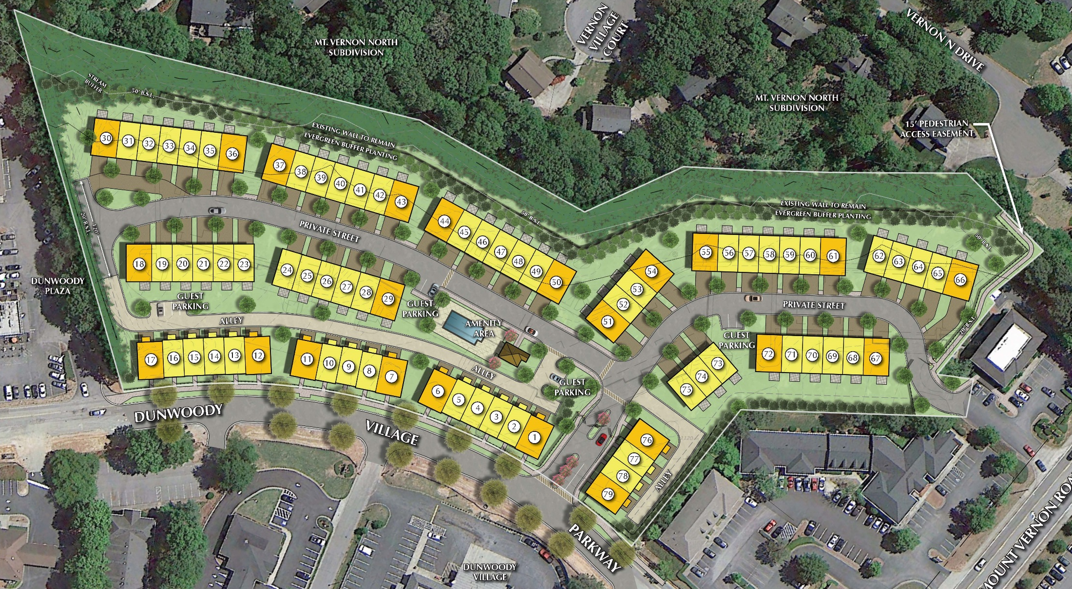
Dunwoody Village Townhomes
a Master Planned Senior Targeted Community
UPDATED SITE PLAN
Site Data
8.34 Acres
79 Townhomes
22 Master-on-Main (approx. 30%)
Elevator Option (100%)

Slide 4
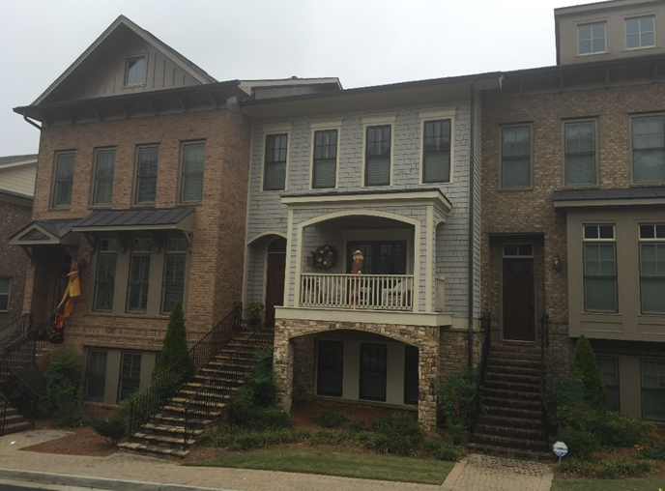
Dunwoody Village Townhomes
a Master Planned Senior Targeted Community
Townhome Elevations

Slide 5
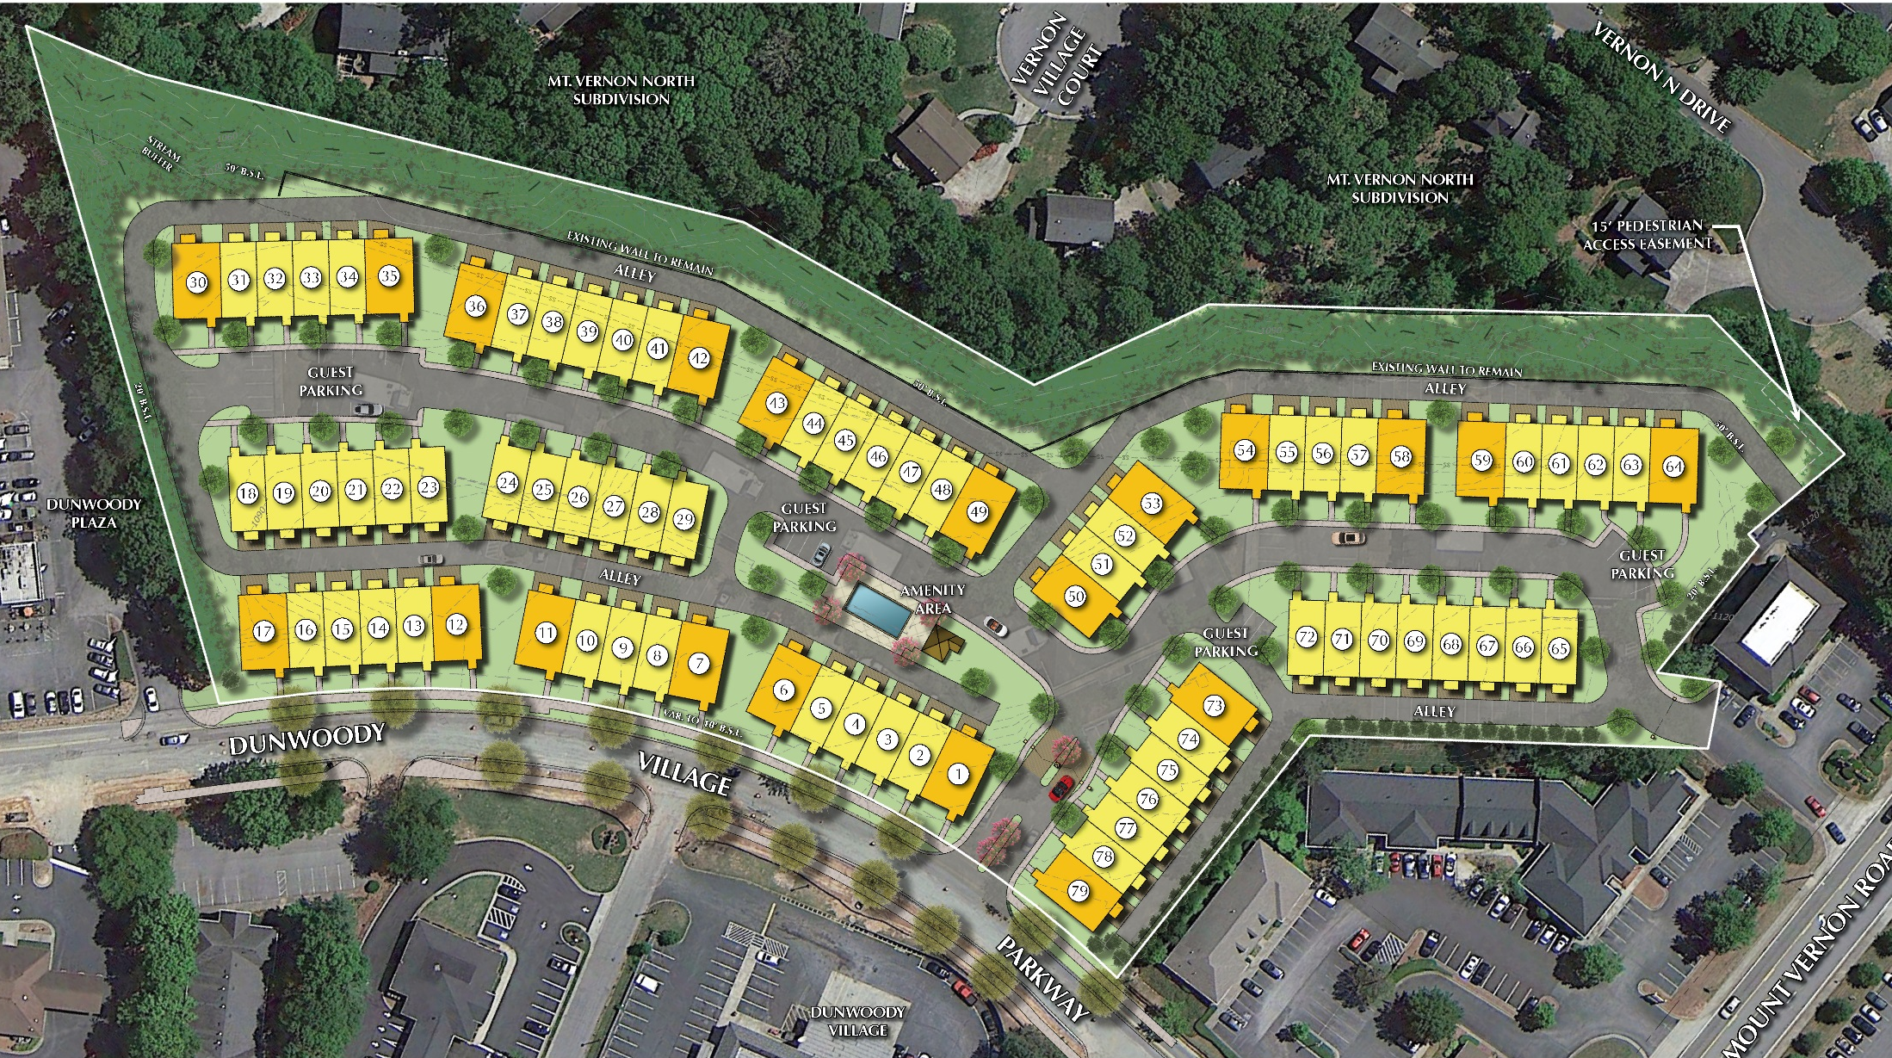
Dunwoody Village Townhomes a Master Planned Residential Community
Site Data
8.34 Acres
79 Townhomes
22 Master-on-Main (approx. 30%)
Elevator Option (100%)
PREVIOUS SITE PLAN

Slide 6
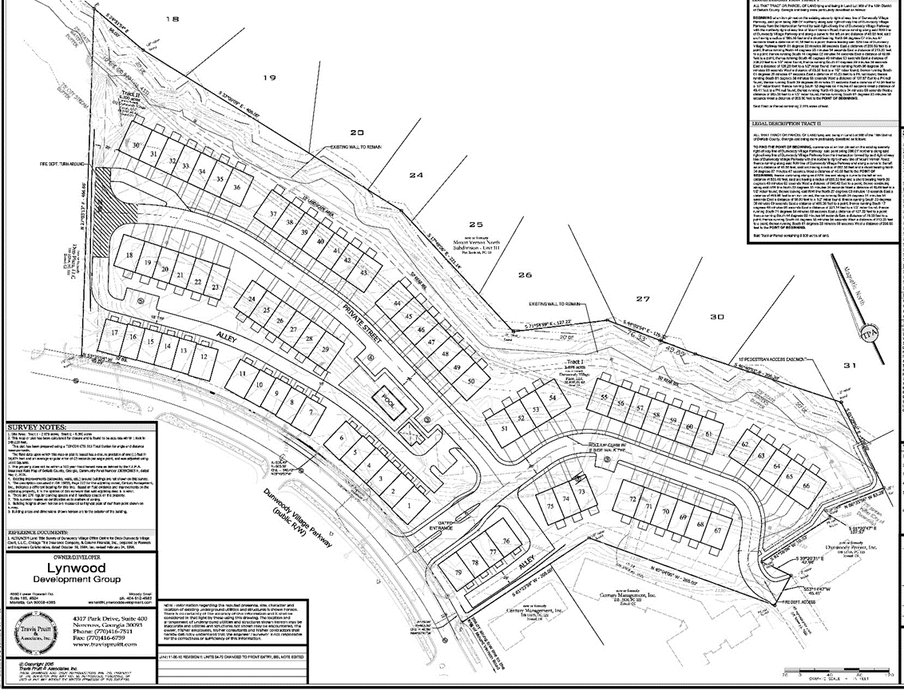
UPDATED ZONING PLAN

