Slide 1
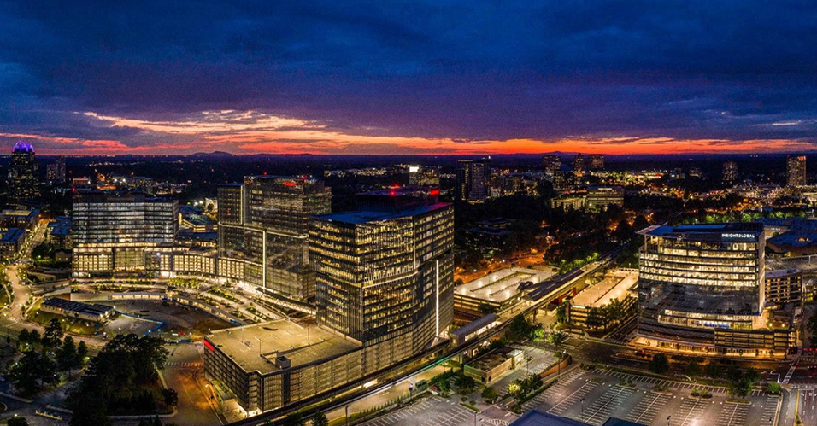
Bonds – The Way Forward
August 2022

Slide 2
History and Today’s Purpose
City Council held a retreat March 21-22.
Discussion at the retreat focused on various financial topics including the operating millage rate and bonding capital projects.
The discussion led to the creation of a Capital Committee which held hearings, along with that topic being addressed at other town halls and City Council meetings.

Slide 3
History and Today’s Purpose
Twelve different public meetings were held on capital and/or bonds on the following dates:
April 11 – Council Meeting (Short Term Capital)
April 25 – Council Meeting (Creation of Capital Committee)
May 6 – Capital Committee
May 17 – Town Hall
May 23 – Council Meeting (Millage and Bond Rates)
May 24 – Town Hall
May 25 – Town Hall
June 10 – Capital Committee
June 23 – Council Meeting (Feedback from Town Halls)
July 11 – Council Meeting (Capital Project List Discussion)
July 15 – Capital Committee
July 25 – Council Meeting (Report of Capital Committee)

Slide 4
History and Today’s Purpose
In the end, these meetings gave focused guidance for staff to work on a bondable project list for future Council discussion.
What staff heard… (Emphasis that this is what was heard, but not yet at a consensus.)
A focus on parks.
A focus on trails.
These two might be mutually exclusive.
Maybe land acquisition.
Maybe transportation.

Slide 5
History and Today’s Purpose
The need for a creation of a citizen committee was brought up.
This could be of any form, but staff recommends looking at one citizen appointee per council member.
The directive to the committee will be to review the staff recommendations that follow in this proposal and report back to the full council.

Slide 6
Staff Initial Recommendation
Staff recommends that Council explore:
One bond of approximately $30 million to develop the Austin Park site, Vermack Park site, along with some improvements to Brook Run Park though not full-fledged completion of the next phase.
To accomplish this, Council will need to approve the current master plan drafts for Austin and Vermack development or approve modified versions of those plans, along with designating some projects within Brook Run Park as having priority in a bond issuance.

Slide 7
Staff Initial Recommendation
Staff recommends that Council explore:
One bond of approximately $30 million to develop a citywide trail system.
To accomplish this, staff recommends that Council (a) adopt the core trail system plan as asked for at the March 2022 Council retreat to be used for (b) a full citywide trail plan to be developed this winter and approve by Council by the 2023 retreat.
Options for transportation could be up to $20 million for finishing all planned sidewalk construction along with major intersection work which could not be handled under SPLOST.

Slide 8
Staff Initial Recommendation
Staff recommends that Council explore:
Determining if there is a need for the issuance of $10 million for land acquisition along with what the intent of future acquisition will encompass.

Slide 9
Staff Initial Recommendation
Staff recommends that Council explore:
Determining if there is a need for the issuance of a transportation bond, knowing that SPLOST will be on the ballot in 2023 and the city, while advocating for a broader use of SPLOST, can keep it for transportation, public safety and repair.

Slide 10
Deliverables Needs
The timeline over the next few slides needs these deliverables approved by council in order to go forward.
Core Trail System Plan
Citywide Trail System Plan
Austin Master Plan
Vermack Master Plan
Brook Run – Improvement List

Slide 11
Proposed Time Line
September 19
Presentation of Core Trail Plan requested at retreat.
Approval of citywide trail plan. (PATH)
October 10
Presentation of Austin and Vermack master plans; presentation of Brook Run priorities.
Approval of Core Trail Plan requested at retreat.
October 24
Approval of Austin and Vermack master plans; approval of Brook Run priorities.

Slide 12
Proposed Time Line
February 2023
Presentation of early draft of citywide trail system.
March 2023
Updated draft of citywide trail system at Council Retreat.
March 2023
Discussion of bond options and SPLOST renewal at Council Retreat.
May 2023
Approval of citywide trail system. (PATH)
Council vote on bond resolution.
November 2023
Potential citizen vote on bonds and SPLOST.

