Slide 1
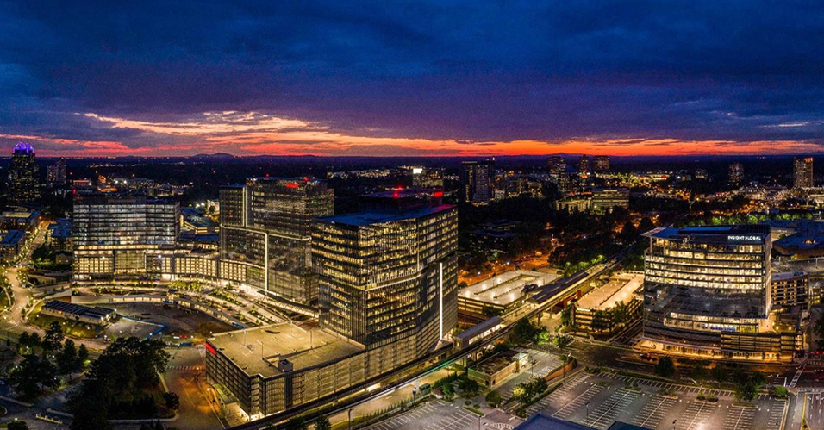
City Council Retreat Pedestrian Safety
March 22-23, 2023

Slide 2
2022 Quick Build Safety Projects

Slide 3
2023 Pedestrian Projects
Sidewalk/Paths to Complete in 2023
Sidewalks/Paths in Design
Sidewalk Repair
2023 Quick Build Projects
Pedestrian Signal Projects in Design
2023 Crosswalk Improvement at Hammond

Slide 4
Safe Streets Program Manager For First Year
Jonathan DiGioia has begun work, and will be in the office an average of one day per week. He is reachable by email at jonathan.digioia@dunwoodyga.gov
He will be joined by others from AECOM who will be assisting.
Coordinate with consultant to direct the City of Dunwoody's Transporation Safety Action Plan. This is due in the Fall 2023. The Safe Street Program Manger will coordinate with Police, Public Works and Community Development staff to see this plan to completion.
Identify and implement a candidate for a demonstration tactical project.
Create standards for safety improvements like pedestrians crossing, curb bulb outs, etc.
Guide the PATH trail project and help implement the plan.
Review the City's roadway and development policies, codes, and standard details; recommend changes to the Community Development and the Public Works Directors. Policies will be brought to the council with changes to the code for approval.

Slide 5
PATH Foundation Timeframes These times are approximate.
March 15 Last working group meeting
March 30 Draft Trail Master Plan due to working group
April 6 Feedback due from working group
April 14 Staff gives copies to City Council and puts Trail Master Plan on agenda
April 24 Presentation to City Council
May 8 City Council adoption

Slide 6
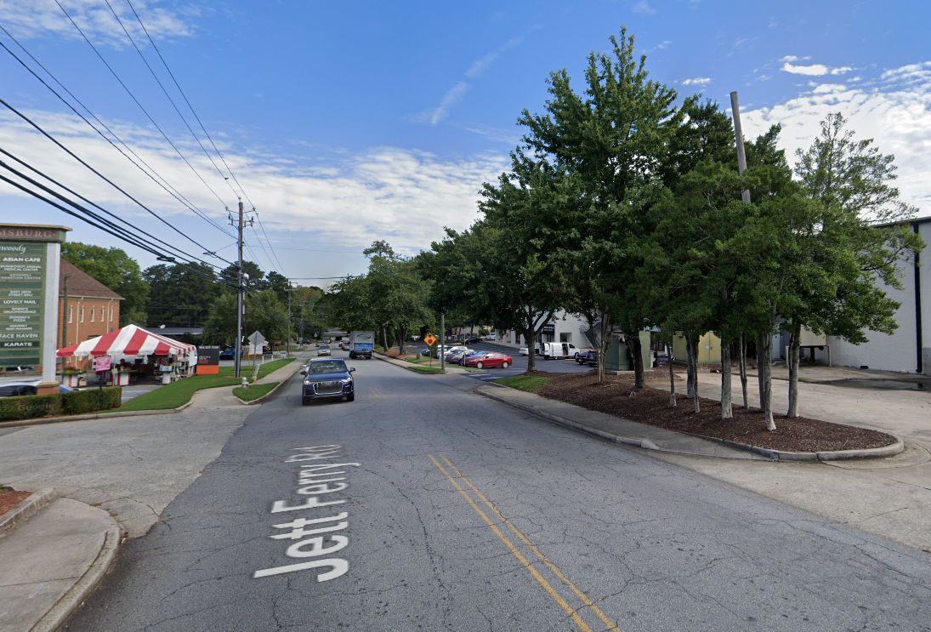
Jett Ferry Streetscapes
There is very little right-of-way (app. 60 feet)
There are sidewalks (5-foot typical, no buffer)
Does the city want to redo them or wait for private development?

Slide 7
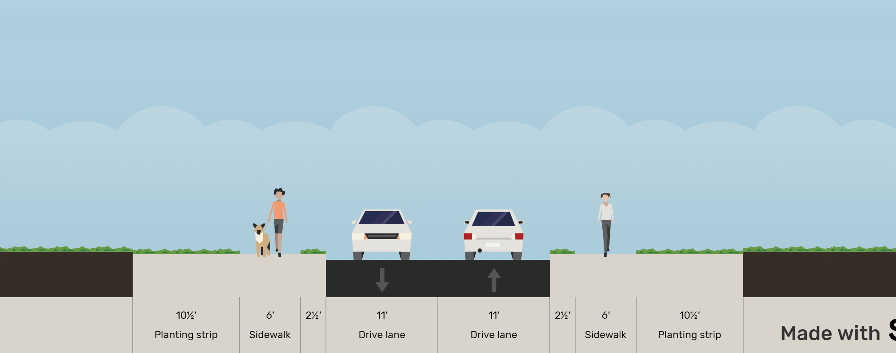
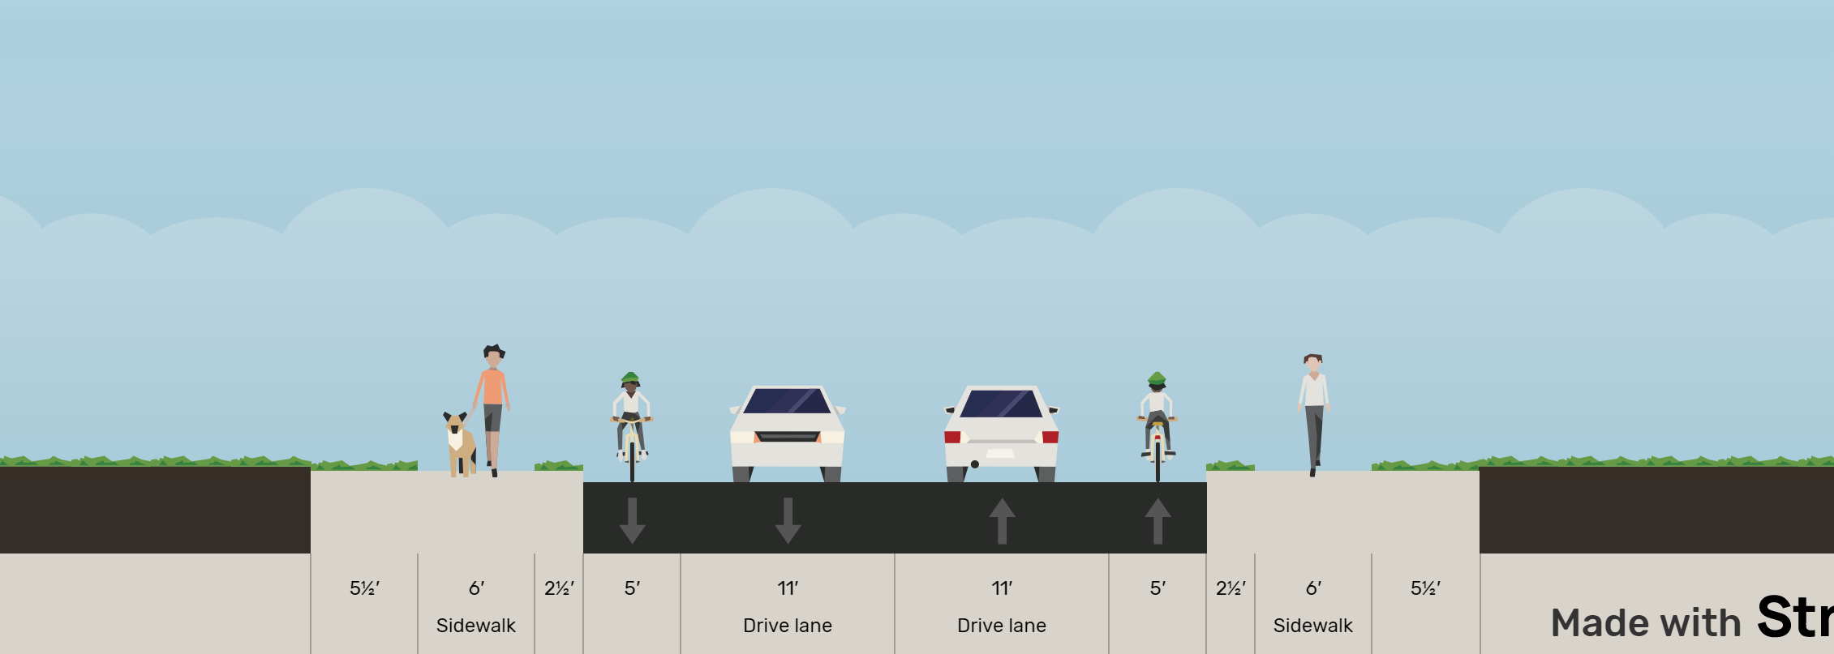
Potential Retrofits in Existing Right of Way
Fits comfortably within existing right-of-way with less utility impacts
May extend out of right-of-way on some parcels; will require retaining walls and utility relocation

Slide 8
Jett Ferry Streetscape
Current code requires:
Street cross-sections. Except as expressly stated in a city-adopted plan (e.g., Dunwoody Village) or within the city's standards and specifications, all streets must be designed and constructed in substantial compliance with the regulations of the table below.
Type | Travel Lanes | Bike Lanes | Curb and Gutter | Shoulder [1]
Arterial and collector streets | 11' | 2 @ 4' | 2 @ 2' | 2 @ 13'
Local streets | 10' | 0 | 2 @ 2' | 2 @ 13'

Slide 9
Jett Ferry Streetscape

