Slide 1
City Council Retreat Constituency Response / Customer Service / RFPs
March 22-23, 2023

Slide 2
Issues
What is the best method for Council to respond when contacted as a group by a citizen or citizens?
Major construction projects cause disruptions. What methods does/can the city use to hold vendors accountable?
How is See, Click Fix and iWorq managed and what are most recent stats?

Slide 3
Issues
What is the best method for Council to respond when contacted as a group?
In most cases, reply individually. Do not "reply to all."
For emergencies – Feel free to contact staff that oversees the issue and notify Council that you did. This will avoid multiple requests.

Slide 4
Issues
What is the best method for Council to respond when contacted as a group?
For non-emergencies, if staff or the city manager is CCed on the email, let one of them make the response.
If they are not copied, forward to the city manager, copying council and the citizen to indicate that staff will respond.
When issues are resolved, staff will send Council an email with its resolution.
Of course, there will be exceptions.

Slide 5
Issues
What is the best method for Council to respond when all of them as a group?
For non-emergencies, if staff or the city manager is CCed on the email, let one of them respond back.
If they are not copied on it, forward to the city manager, copying council and the citizen that staff will respond?
When issues are resolved, staff will send Council and email with its resolution.
Of course, there will be exceptions.

Slide 6
Code enforcement complaints
iWorq cases for code enforcement.
In 2022 we received 610 code complaints.
12 of these were held longer than 90 days.
Citizens are updated by the investigating inspector periodically during the investigation of a reported complaint.
There are some cases when an update may not come until after the violation has been brought into compliance.
Privacy issues and sensitive information are two reasons updates to the complainant may not be ongoing, but in most cases the inspectors keep regular contact with the complainant.
This contact may be through email from the inspectors city email account, by phone, or in person visits to the complainant home.

Slide 7
Process of code enforcement
COMPLAINT RECEIVED - A complaint is received and a case is opened. If the complaint pertains to another department or agency, it is referred and then closed.
INVESTIGATION - Code Enforcement Officers conduct an investigation, which may include performing research, conducting interviews, sending correspondence, inspecting sites, and making determinations.
ENFORCEMENT* - Enforcement steps may include written warnings, orders to correct, citations and fees, ordering unsafe buildings or sites to be closed or vacated, and enforcement of permits.

Slide 8
Process of code enforcement
HEARING* - Parties may appeal enforcement actions and request a trial or speak with the city solicitor. The process includes case preparation, correspondence, scheduling and holding a hearing, and issuing final notices.
FINAL PROCESSING & CLOSED** - Final processing occurs when the complaint is referred, unfounded, or abated.
*The Enforcement phase and the Hearing phase may not be a part of every case, and after a Hearing, a case can transfer back to Enforcement.
**A case can be closed at any point in the process

Slide 9
Public Works Maintenance

Slide 10
Public Works Maintenance
Status of Service Requests Initiated in last 12 months

Slide 11
Public Works Maintenance

Slide 12
Public Works Maintenance

Slide 13
Issues
Major construction projects cause disruptions. What methods does/can the city use to hold vendors accountable?

Slide 14
State Law for Public Works Projects
Low Bid Required
Public Works construction contracts > $100,000
Road projects >$200,000
What is considered a Public Works project?
Public structures or other public improvements to real property
Notable exceptions
Emergencies
Professional services such as architecture and engineering

Slide 15
Prequalification of Contractor
O.C.G.A. 36-91-20(f)
Criteria for prequalification must be reasonably related to the project
Examples
Experience with similar projects
Licensure
Must award to responsive and responsible bidder. Examples of factors that can be considered:
Experience with similar projects
Ability to perform within the specified schedule
Financial stability, bonding capacity, safety record

Slide 16
Alternative Delivery Methods for Construction
Method | Advantages | Disadvantages
Design-Build | Typically shortens timeline from design to construction Contractor has input on design items which may affect cost | Owner relinquishes much of the control over the design and construction methods Conflict of interest between owner and design team
Construction Manager at Risk | Contractor has input on design items which may affect cost | Costs tend to be higher in less competitive environment
Both methods are commonly used for building construction. More challenging to apply to transportation projects where negotiation with adjacent residents is necessary and utilities impact design and construction.

Slide 17
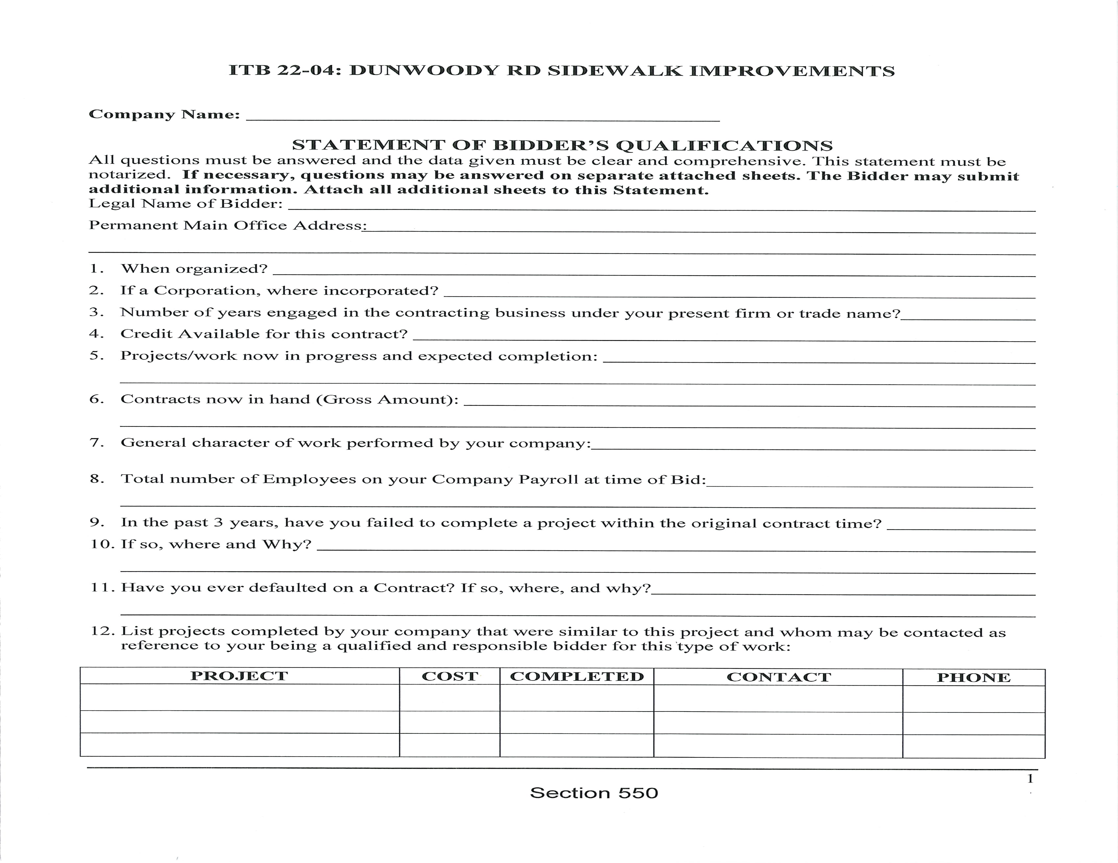
City Tools for Contractor Quality and Accountability
Statement of Qualifications and References

Slide 18
City Tools for Contractor Quality and Accountability
Utilize on-call contracts with pre-selected contractors used for small projects when possible
Require prime contractor to perform at least 35% of the work
Assess liquidated damages of $500 to $800 per day for late completion
Assess liquidated damages for non-compliance with traffic control requirements
Utilize third party quality control testing and require as-built documentation to confirm compliance with specifications.
Internal project review after completion
Vetting and approval of contractor's project manager and superintendent
Enforcement of penalties has often resulted in poor performing contractors not pursuing future work in the city

Slide 19
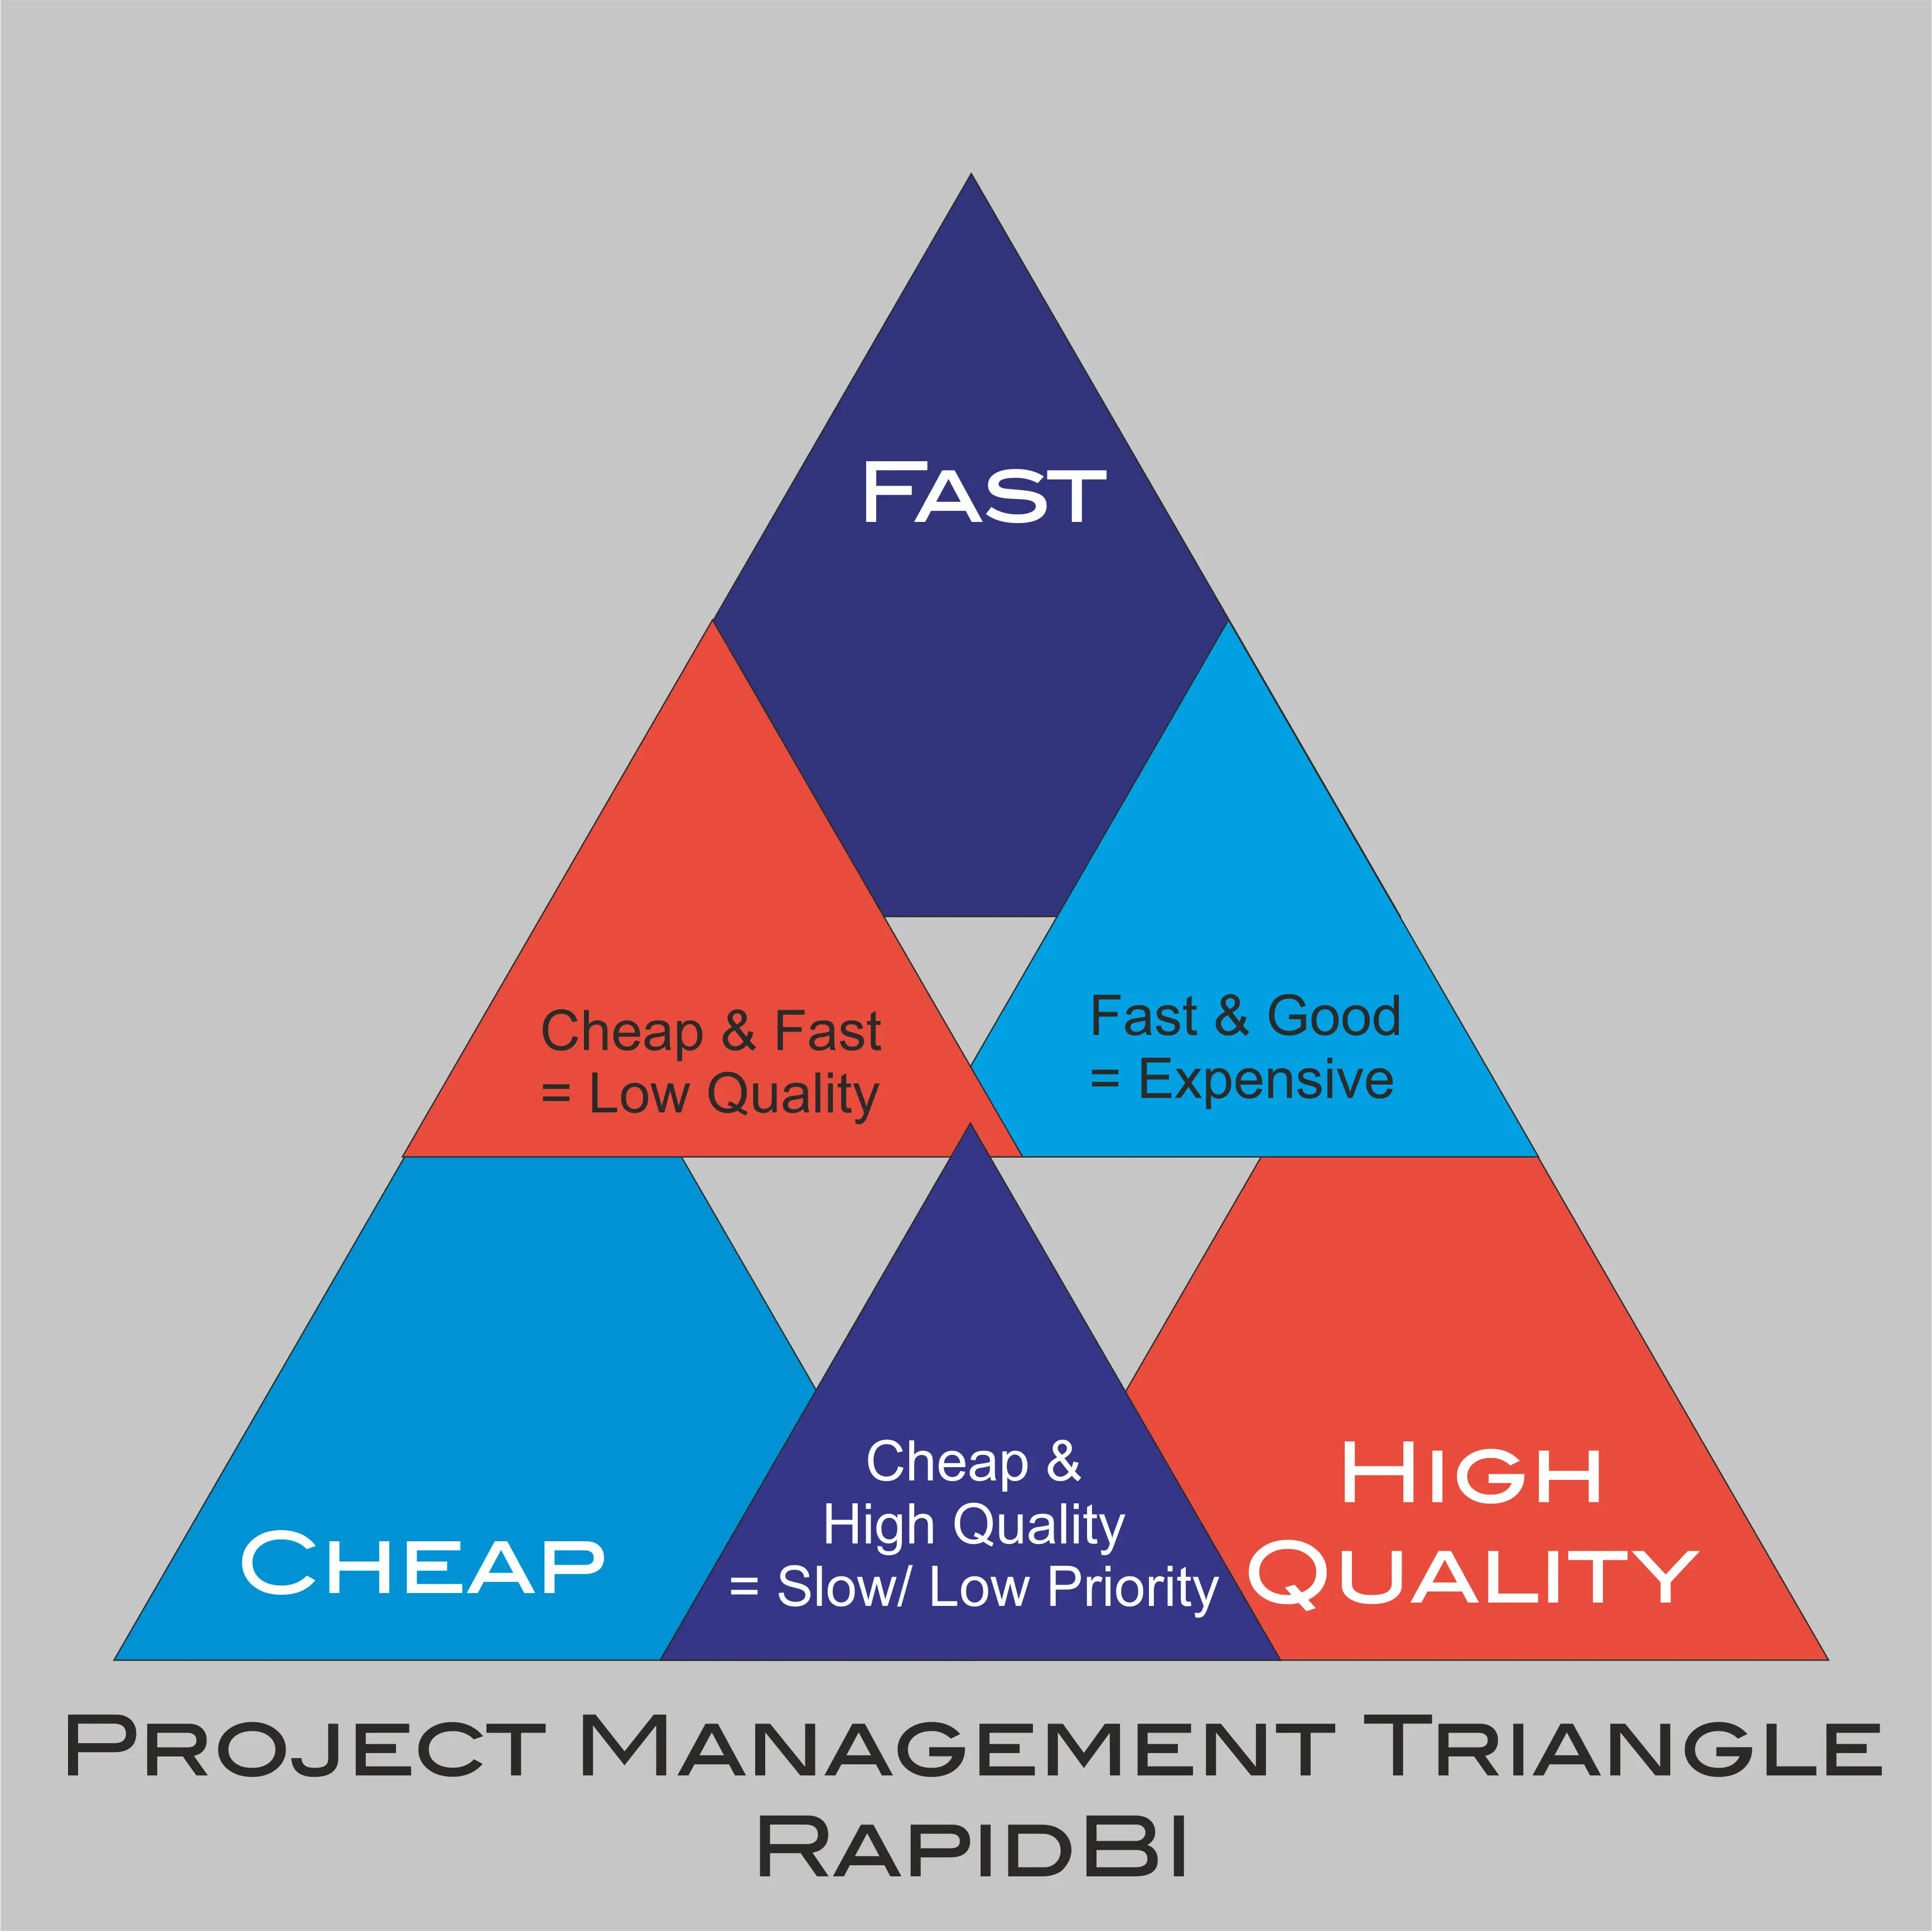

Slide 20
Potential Options for Elevated Oversight
Increase staff time allocated to each project
Construction Manager
Field Representative
Project 1
Field Representative
Project 2
Project 3
Field Representative
Field Representative
Project 4
Construction Manager
Field Representative
Project 1
Project 2
Project 3
Field Representative
Project 1
Current Staffing Model
2 FTEs
Increased Staffing Model
5 FTEs
Increase total project cost 3 to 5%

Slide 21
Potential Options for Higher Performance
Offer financial incentives for contractor to finish ahead of schedule

